Slide 1
Decking Collection Rack Rollout Process
Mike Benzy Sr. Analyst – Claims Prevention / NA District
Dusty Roberts Advisor – Program Management / Strategic Planning & Support
January 2017

Slide 2
Decking Rack Rollout Process Overview
Step 1: Initial data is supplied to the rollout centers
Friday, January 20, 2017 for Wave 1 Friday, February 17, 2017 for Wave 2 Friday, March 17, 2017 for Wave 3
Step 2: A conference call is scheduled with the SCM, SA-CP, and MGR-Service Assurance
Wednesday, January 25, 2017 for Wave 1 Wednesday, February 22, 2017 for Wave 2 Wednesday, March 22, 2017 for Wave 3
Step 3: Centers order supplies
Immediately after their wave call, but not before
Step 4: Support schedules an initial setup visit based off the projected delivery date
Step 5: Support assists with dock location selection & education
Step 6: 2-Week out SA-CP follow-up

Slide 3
Step 1: Initial Data Is Supplied To The Rollout Centers
Green Excess Decking Beam Rack / Wave 1
REG DI CNTR SCM SA-CP DOM MGR-SA
NOWE PL SEA DUANE CHERNOFF CARSON TRAFTON POR RENE LOPEZ
SOEA OR ORL P. BROOKOVER SEAN PIERCE ORL ROSS HOLCOMB
NOWE MR SBO RUSS FLECK LESTER HESSE MRL RENE LOPEZ
NOWE SC SAC JOE CHARBONNEAU LARRY THOMAS SAC RENE LOPEZ
NOWE SC OAK J. SOUTHWORTH LARRY THOMAS SAC RENE LOPEZ
NOWE SC SJC R. VILLANUEVA LARRY THOMAS SAC RENE LOPEZ
NOWE WT GAR DAVID CHACON MARK OJEDA WHT RENE LOPEZ
NOWE WT WHT ANDY LESSIN MARK OJEDA WHT RENE LOPEZ
NOEA PO POS DALE SYMONS GEORGE PARKER WNJ MARKUS STOMMEN
CAND CA WTO MARK STRACHAN DARA LAY HFD KATHLEEN CRAWFORD
NOEA HF HFD JEFF BAUSCH MICHAEL MONAGHAN HFD MARKUS STOMMEN
NOWE PX NPX ED MCDERMOTT MARK MADSEN NPX RENE LOPEZ
NOEA PO CIN D SHELLENBERGER GEORGE PARKER WNJ MARKUS STOMMEN
SOEA OR HWO ROY WETHY SEAN PIERCE ORL ROSS HOLCOMB
NOWE DN DEN AARON HOLLIS MATT FIKE NSL RENE LOPEZ
NOEA HB NHS LEN MYERS LONNIE HAMMAKER NHS MARKUS STOMMEN
NOEA SN DRT DAVID HUGHES JASON COTTEN HOU MARKUS STOMMEN
SOWE HU BTR CHRIS PANKS JASON COTTEN HOU MARK KEELING
NOWE PL POR MIKE HARRIS CARSON TRAFTON POR RENE LOPEZ
NOEA HF NWB S. LAMBERTON MICHAEL MONAGHAN HFD MARKUS STOMMEN

Slide 4
Step 1: Initial Data Is Supplied To The Rollout Centers
Red Damaged Decking Beam Rack / With Wave 1 Green Rack Rollout
REG DI CNTR SCM SA-CP DOM MGR-SA
SOEA CL CLT BILL AGNEW MICHELE BLAKE CLT ROSS HOLCOMB
NOWE WT WHT ANDY LESSIN MARK OJEDA WHT RENE LOPEZ
NOWE MR MRL BOB TILLETT LESTER HESSE MRL RENE LOPEZ
NOWE DN DEN AARON HOLLIS MATT FIKE NSL RENE LOPEZ
NOEA HF NWB S. LAMBERTON MICHAEL MONAGHAN HFD MARKUS STOMMEN
MIWE ST DSM NATE GRIGGS MARK WOFFORD STL KELLI OSTERTAG
SOEA OR ORL P. BROOKOVER SEAN PIERCE ORL ROSS HOLCOMB
NOWE PL SEA DUANE CHERNOFF CARSON TRAFTON POR RENE LOPEZ
MIWE ST STL CORY HERRMAN MARK WOFFORD STL KELLI OSTERTAG
Initial data rolled out to Wave 1 locations, SA-CP’s, & MGR-SA’s: Friday, January 20, 2017
Conference call to discuss ordering, rollout, setup, & expectations: Wednesday, January 25, 2017

Slide 5
Step 1: Initial Data Is Supplied To The Rollout Centers
Green Excess Decking Beam Rack / Wave 2
REG DI CNTR SCM SA-CP DOM MGR-SA
SOEA AT ATL TOMMY LAMBERT DEREK DALLAS ATL ROSS HOLCOMB
MIWE ST DSM NATE GRIGGS MARK WOFFORD STL KELLI OSTERTAG
SOWE KC WTK TYLER FLEMING ROGER GEARY KCY MARK KEELING
NOWE MR SLV DAVID ROCCO LESTER HESSE MRL RENE LOPEZ
NOWE MR MRL BOB TILLETT LESTER HESSE MRL RENE LOPEZ
NOEA HG HGR JASON LEWIS LONNIE HAMMAKER NHS MARKUS STOMMEN
NOEA HF AVO CLINT ALLISON MICHAEL MONAGHAN HFD MARKUS STOMMEN
NOWE MR SDO BOB CANTY LESTER HESSE MRL RENE LOPEZ
SOEA OR MDL ROY WETHY SEAN PIERCE ORL ROSS HOLCOMB
MIWE ST WTL NATE DIXSON MARK WOFFORD STL KELLI OSTERTAG
NOWE WT KTL ARMANDO MAGANA MARK OJEDA WHT RENE LOPEZ
NOWE WT SFV GREG SULLIVAN MARK OJEDA WHT RENE LOPEZ
SOEA ME JKM SCOTTIE STUBBS JACOB KIRKPATRICK BHM ROSS HOLCOMB
NOWE WT SLG MATT LOWE MARK OJEDA WHT RENE LOPEZ
NOWE PX AQE RUDY ROMO MARK MADSEN NPX RENE LOPEZ
NOWE PL SPO BEN JAGELSKI CARSON TRAFTON POR RENE LOPEZ
SOWE SN AMA JOYCE SULLINS JASON COTTEN HOU MARK KEELING
NOWE SC PET STEVE ROLLS LARRY THOMAS SAC RENE LOPEZ
NOWE SC STK JW GURTIS LARRY THOMAS SAC RENE LOPEZ
SOWE KC FAR ANTHONY BRAATEN ROGER GEARY KCY MARK KEELING
NOWE PL HMS TOM MELDER CARSON TRAFTON POR RENE LOPEZ

Slide 6
Step 1: Initial Data Is Supplied To The Rollout Centers
Red Damaged Decking Beam Rack / With Wave 2 Green Rack Rollout
REG DI CNTR SCM SA-CP DOM MGR-SA
NOEA HG HGR JASON LEWIS LONNIE HAMMAKER NHS MARKUS STOMMEN
SOEA NA LOU JIM MINIUM MIKE BENZY NAS ROSS HOLCOMB
NOEA PO POS DALE SYMONS GEORGE PARKER WNJ MARKUS STOMMEN
SOEA ME WME AARON LAGING JACOB KIRKPATRICK BHM ROSS HOLCOMB
MIWE CH CGX TIM DOODY DANNY MELLIS CGT KELLI OSTERTAG
MIWE RK RKI DAN CONWAY KEVIN NORVILLE RKI KELLI OSTERTAG
SOEA CL GSP RICH NOEL MICHELE BLAKE CLT ROSS HOLCOMB
SOWE DA FTW MIKE GARRISON DANNY MCGUIRE DAL MARK KEELING
SOEA CL GBO ADAM DOWNS MICHELE BLAKE CLT ROSS HOLCOMB
NOEA YN TOL JACOB GARNER GEORGE GRIMES YNG MARKUS STOMMEN
Initial data rolled out to Wave 2 locations, SA-CP’s, & MGR-SA’s: Friday, February 17, 2017
Conference call to discuss ordering, rollout, setup, & expectations: Wednesday, February 22, 2017

Slide 7
Step 1: Initial Data Is Supplied To The Rollout Centers
Green Excess Decking Beam Rack / Wave 3
REG DI CNTR SCM SA-CP DOM MGR-SA
NOWE DN GJN JEFFREY BLACK MATT FIKE NSL RENE LOPEZ
SOWE LI LIT FRANK DYER SCOTT WESSEL LIT MARK KEELING

Slide 8
Step 1: Initial Data Is Supplied To The Rollout Centers
Red Damaged Decking Beam Rack / With Wave 3 Green Rack Rollout
REG DI CNTR SCM SA-CP DOM MGR-SA
SOWE HU SHV CHRIS CHANDLER JASON COTTEN HOU MARK KEELING
SOWE HU HOU FERRELL HYATT JASON COTTEN HOU MARK KEELING
NOEA HF HFD JEFF BAUSCH MICHAL MONAGHAN HFD MARKUS STOMMEN
NOWE PL POR MIKE HARRIS CARSON TRAFTON POR RENE LOPEZ
NOEA YN CMH RICK CRISENBERY GEORGE GRIMES YNG MARKUS STOMMEN
SOWE KC WTK TYLER FLEMING ROGER GEARY KCY MARK KEELING
MIWE ST SGF BROOK WHEELER MARK WOFFORD STL KELLI OSTERTAG
MIWE RK EFH SCOTT RICHES KEVIN NORVILLE RKI KELLI OSTERTAG
SOWE LI OKC WINFORD NAVRATH SCOTT WESSEL LIT MARK KEELING
NOEA PO SNW CHARLES LONG GEORGE PARKER WNJ MARKUS STOMMEN
NOWE PX PHX SCOTT DEPOTO MARK MADSEN PHX RENE LOPEZ
SOWE KC FAR ANTHONY BRAATEN ROGER GEARY KCY MARK KEELING
SOEA NA KNX ANTHONY JOHNSON MIKE BENZY NAS ROSS HOLCOMB
SOEA ME JKM SCOTTIE STUBBS JACOB KIRKPATRICK BHM ROSS HOLCOMB
SOEA OR VLD RANDY WICKER SEAN PIERCE ORL ROSS HOLCOMB
NOWE DN BTE GREG PETERS MATT FIKE NSL RENE LOPEZ
MIWE ST MSP JEFF MCKENZIE MARK WOFFORD STL KELLI OSTERTAG
MIWE RK MAU STEVE CARPENTER KEVIN NORVILLE RKI KELLI OSTERTAG
Initial data rolled out to Wave 3 locations, SA-CP’s, & MGR-SA’s: Friday, March 17, 2017
Conference call to discuss ordering, rollout, setup, & expectations: Wednesday, March 22, 2017

Slide 9
Step 1: Initial Data Is Supplied To The Rollout Centers
The Sr. Analyst – Claims Prevention responsible will provide the following information to each center receiving a rack:
1. 25-Day Average Over Current Decking Allocation (Green racks only)
This data can be derived from the Daily Decking Inventory Charts for each operation region:
H:\GO\CLAIMPRE\Decking\Decking Trends\Daily Decking Inventory Charts CAND.xlsb
H:\GO\CLAIMPRE\Decking\Decking Trends\Daily Decking Inventory Charts MIWE.xlsb
H:\GO\CLAIMPRE\Decking\Decking Trends\Daily Decking Inventory Charts NOEA.xlsb
H:\GO\CLAIMPRE\Decking\Decking Trends\Daily Decking Inventory Charts NOWE.xlsb
H:\GO\CLAIMPRE\Decking\Decking Trends\Daily Decking Inventory Charts SOEA.xlsb
H:\GO\CLAIMPRE\Decking\Decking Trends\Daily Decking Inventory Charts SOWE.xlsb
2a. Inform Receiving Center of Decking Plan Movement Locations (Green racks only)
Referenced from the Decking Movement Plan: Decking Movement Plan
2b. Inform Receiving Center of Decking Repair Locations (Green and Red racks)
ATL, BOL, DAL, DAY, IND, KCY, LIT, NEM, NHS, RCH, SAC, SBO, YNG

Slide 10
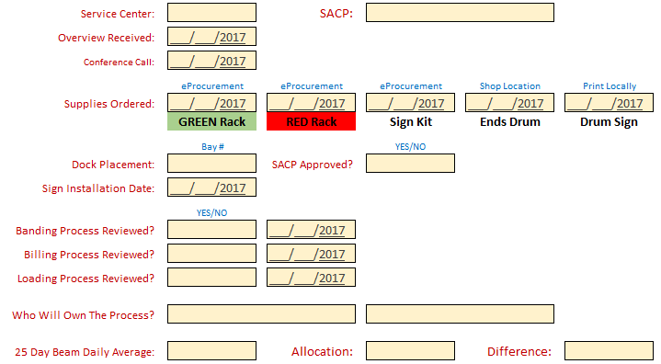
Step 1: Initial Data Is Supplied To The Rollout Centers
Rollout Worksheet Print Sheet:
Print this page and use as a personal reference when different events happen
Please use the “Entry Sheet” to enter dates and confirmations so we can keep track of where we are at with the process
Filter the entry sheet to your region, district, or centers to stay on track
H:\GO\CLAIMPRE\Decking\Decking Trends\Rack Rollout Worksheet.xlsx

Slide 11
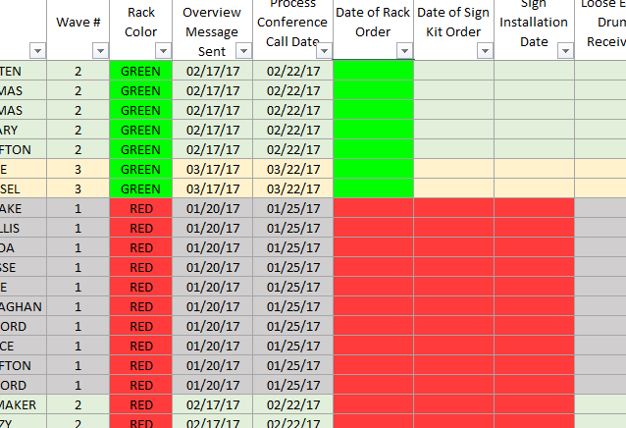
Step 1: Initial Data Is Supplied To The Rollout Centers
Rollout Worksheet:
Cells are color-coded by wave # + beam rack type
H:\GO\CLAIMPRE\Decking\Decking Trends\Rack Rollout Worksheet.xlsx

Slide 12
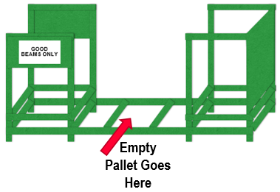
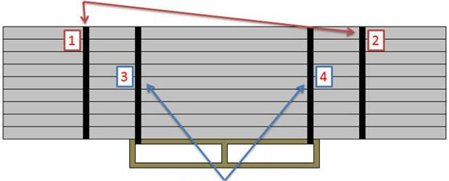

Step 1: Initial Data Is Supplied To The Rollout Centers
Excess (GREEN) Decking Rack Overview:
DOCK PLACEMENT
RACK SETUP
BANDING PROCESS
Centralized dock location with maximum visibility and exposure to traffic
Chosen location is permanent and rack should not ever be moved around the dock
These racks are not for beam storage
BILLING PROCESS
LOADING PROCESS
Bill as a C0 type sub-bill
BEAM keyword for excess beams
Please weigh before billing
Please enter the total billed
Loaded in trailers sideways to maximize cube
Entire dock works together to fill
Who is responsible to monitor and band when the rack reaches the desired amount, based off the 25-day average per day? (Green racks only)

Slide 13
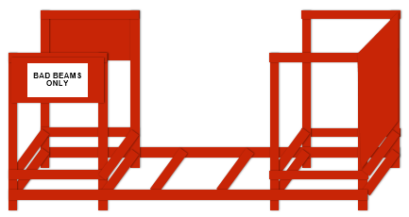
Step 1: Initial Data Is Supplied To The Rollout Centers
Bad Beam (RED) Decking Rack Overview:
DOCK PLACEMENT
RACK SETUP
BANDING PROCESS
“BAD BEAMS” Sign Hung Directly Above
Centralized dock location with maximum visibility and exposure to traffic
Chosen location is permanent and rack should not ever be moved around the dock
These racks are not for beam storage
Empty Pallet Goes Here
BILLING PROCESS
LOADING PROCESS
Entire dock works together to fill
Who is responsible to monitor and band when the rack is full of damaged beams? (Red racks only)
Load rack until ¾ full, then band & remove
Bill as a C0 type sub-bill
BROK keyword for damaged beams
Please weigh before billing
Please enter the total beams billed
Loaded in trailers sideways to maximize cube (if possible)

Slide 14
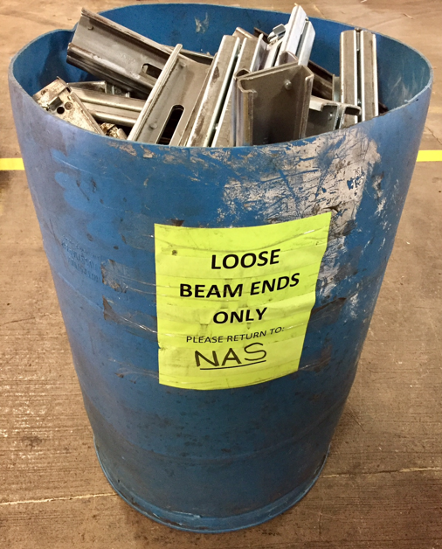
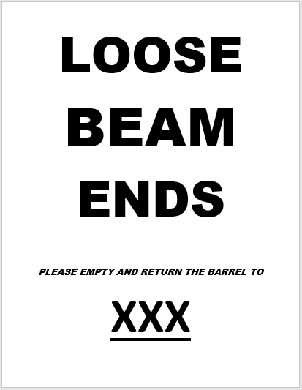
Step 1: Initial Data Is Supplied To The Rollout Centers
Loose Decking Beam End Collection Drum Overview:
DOCK PLACEMENT
Obtain a clean, empty drum from a shop location
Save the label to your file
Change “XXX” to your center
Centralized dock location with maximum visibility and exposure to traffic
Chosen location is permanent and drum should not ever be moved around the dock
Place next to the banding racks
BILLING PROCESS
Bill as a C0 type sub-bill
BROK keyword for loose beam ends
Please weigh before billing
Please enter 120 as the total billed for full drums
Loose Beam Ends Label Link

Slide 15

Step 2: A conference call is scheduled with the SCM, SA-CP, and MGR-Service Assurance
Decking Rack Overview
How To Order
Dock Placement
Rack Setup
Sign Installation (Red Damaged Beam Racks Only)
Banding Process
Billing Process
Loading Process
How it all gets done – Who will own it?
Scheduling a visit from the SA-CP if needed
Utilizing the worksheet
10-day follow-up
Amount billed & billed correctly?
Is it still in the same location?
Usage feedback
Any questions or concerns with the equipment or process?

Slide 16
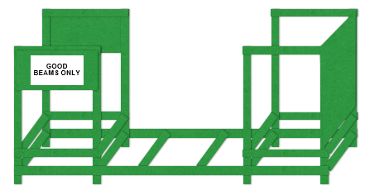
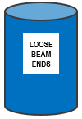
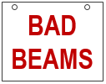
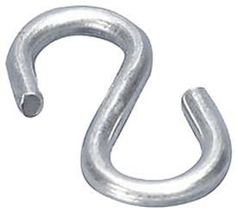
Step 3: Centers Order Supplies
eProcurement Vendor Item Descriptions
Excess Good Beam Rack (59682) $695.00 EACH
GOOD BEAM RACK – EXCESS DECKING BEAM CONSOLIDATION CART 94 1
BEARDS WELDING
Damaged Beam Rack (59683) $695.00 EACH
BAD BEAM RACK – DAMAGED DECKING BEAM CONSOLIDATION CART 94 1
BEARDS WELDING
Bad Beams Sign Kit (59696) $70.00 EACH
SIGN, BAD BEAMS 36X24 RED AND WHITE VINYL (4) S-HOOKS, 36”
IBISTEK SIGNS & ACCESSORIES
55 Gallon Drum Get From Shop Locations
Loose Ends Sign for Drums Print Locally
EXCESS GOOD BEAM RACK
DAMAGEDBEAM RACK
(Sign + Accessories included in kit)

Slide 17
Step 4: Support schedules an initial setup conference call (or visit) based off the projected delivery date
It is extremely important that someone from a support role is able to assist with the setup & initial round of collecting, banding, billing, & loading onto a trailer. We can all become accustomed to certain routines when it comes to the handling of beams, so it is vitally important this particular proven method is followed exactly as intended.
Step 5: Support assists with dock location selection & education
Proper dock location is key. These collection racks need to in in the center of the action to contribute to wasted time on the dock surrounding the management of excess good or bad beams. If one of these tools is placed out of the way, all the benefits associated with them go away. Docks must be reminded of the following:
These racks are not for storage. Once a beam goes in, it does not come out.
Everyone needs to contribute. Many hands make light work!
The rack locations are permanent. Get comfortable with a placement, then leave it there.
Step 6: 2-Week out SA-CP follow-up
Check to see if the proper amount is getting billed, if the tools are in the same location, and gather any usage feedback. Can be done remotely if desired.

Slide 18
THANK YOU!

